Slide 1

Professional Practices (HUM-305)
SPRING SEMESTER 2026
By
Prof Engr Muhammad Raheel Iqbal Butt
Resource Person
Contact: +92 321 7433568
School of Computer & Information Technology
Beaconhouse National University, Lahore

Slide 2
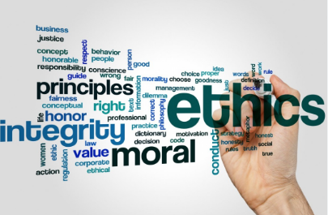

Slide 3
Chap 9 Professional Ethics And Responsibilities
What Is “Professional Ethics”?
Ethical Guidelines for Computer Professionals
Special Aspects of Professional Ethics
Professional Codes of Ethics
Guidelines and Professional Responsibilities
Introduction and Methodology
Protecting Personal Data
Designing an Email System With Targeted Ads
Webcams in School Laptops
Publishing Security Vulnerabilities

Slide 4


Slide 5
What Is “Professional Ethics”?
What Is “Professional Ethics”?
Professional ethics refers to moral principles and standards that guide behavior in a profession
It ensures professionals act with honesty, integrity, and responsibility
In computing, it includes protecting user data, avoiding harm, and maintaining trust
Goes beyond law → something can be legal but still unethical
Example: A developer not misusing user data even if access is available

Slide 6
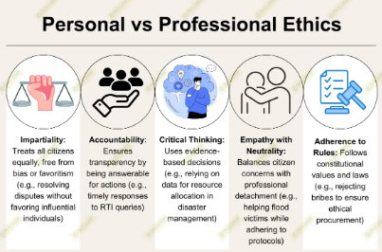

Slide 7
2. Ethical Guidelines for Computer Professionals
2. Ethical Guidelines for Computer Professionals
Respect privacy and confidentiality of users
Ensure accuracy and reliability of systems
Avoid causing harm (physical, financial, or social)
Be transparent about system limitations
Example: Not selling user data without consent
Example: Informing users about data collection policies

Slide 8
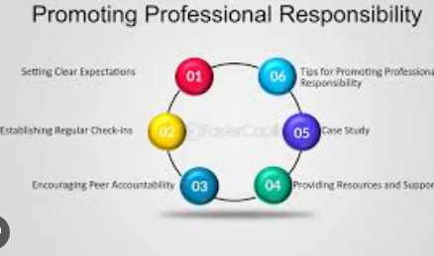

Slide 9
3. Special Aspects of Professional Ethics & 4. Professional Codes of Ethics
3. Special Aspects of Professional Ethics
Technology impacts millions of users simultaneously
Errors can lead to serious consequences (financial loss, safety risks)
Difficulty in assigning responsibility (team-based development)
Rapid technological change creates new ethical dilemmas
Example: AI bias affecting hiring decisions
4. Professional Codes of Ethics
Formal guidelines developed by organizations (e.g., ACM, IEEE)
Provide a framework for ethical decision-making
Promote values like honesty, fairness, and accountability
Help professionals resolve ethical conflicts
Example: ACM Code emphasizes avoiding harm and respecting privacy

Slide 10
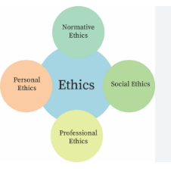

Slide 11
5. Guidelines and Professional Responsibilities
5. Guidelines and Professional Responsibilities
Deliver high-quality, secure, and reliable systems
Maintain confidentiality of sensitive information
Continuously update skills and knowledge
Report unethical practices when necessary
Example: Reporting a security flaw instead of hiding it responsibility toward clients, employers, and society

Slide 12


Slide 13
6. Introduction and Methodology
6. Introduction and Methodology
Ethical decision-making requires a systematic approach
Steps:
Identify the problem
Gather relevant facts
Consider stakeholders (users, company, society)
Evaluate possible actions
Choose the most ethical solution
Example: Deciding whether to release software with known bugs

Slide 14
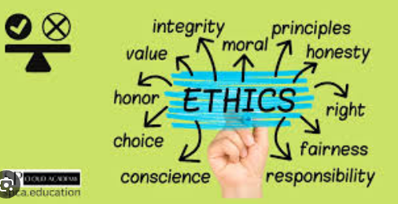

Slide 15
7. Protecting Personal Data
7. Protecting Personal Data
Personal data includes name, CNIC, email, financial details
Risks: Data breaches, identity theft, misuse
Protection methods:
Encryption
Secure authentication
Access control
Example: Companies securing user passwords using hashing
Ethical duty to collect only necessary data

Slide 16


Slide 17
8. Designing an Email System With Targeted Ads
8. Designing an Email System With Targeted Ads
Emails scanned to show relevant advertisements
Ethical concerns:
Privacy invasion
Lack of user consent
Benefits:
Free services funded by ads
Ethical approach:
Transparency (inform users clearly)
Provide opt-out options
Example: Email services showing ads based on user activity

Slide 18
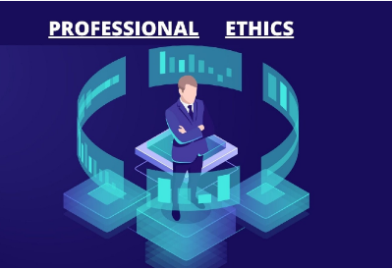

Slide 19
9. Webcams in School Laptops
9. Webcams in School Laptops
Schools may install webcams for security or monitoring
Ethical issues:
Violation of student privacy
Unauthorized surveillance
Risks:
Hacking of webcams
Monitoring without consent
Ethical solution:
Clear policies
Consent from students/parents
Limited and secure usage
Example: Cases where schools secretly monitored students

Slide 20


Slide 21
10. Publishing Security Vulnerabilities
10. Publishing Security Vulnerabilities
Discovering flaws in systems (software, websites)
Ethical dilemma:
Should it be disclosed publicly or privately?
Responsible disclosure:
Inform company first
Give time to fix the issue
Risks of full public disclosure:
Hackers may exploit vulnerabilities
Example: Ethical hackers reporting bugs to companies

Slide 22


Slide 23


